Slide 1

Cynthia Li
Models and Implementation

Slide 2
Matrix Factorization Notebook
Demonstrate how to use the tensorflow API to implement a matrix factorization model (ALS)

Slide 3
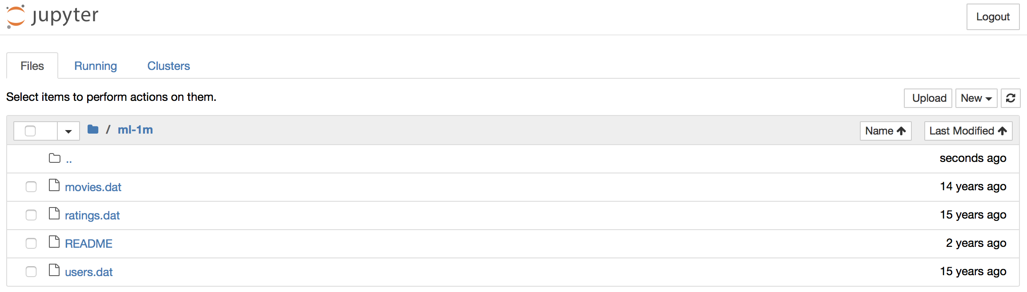
Our Dataset
Our dataset: Movielens 1m dataset
http://files.grouplens.org/datasets/movielens/ml-1m.zip
Notes:
Recall that the wide component is a generalized linear model of the form y = w^T x + b, as illustrated above (left).
One of the most important transformations is the cross-product transformation, which we saw earlier.It it defined here, where c-ki is a boolean variable that is 1 if the ith feature is part of the k-th transformation k, and 0 otherwise.For binary features, a cross-product transformation (e.g., “AND(gender=female, language=en)”) is 1 if and only if the constituent features (“gender=female” and “language=en”) are all 1, and 0 otherwise. This captures the interactions between the binary features, and adds nonlinearity to the generalized linear model.

Slide 4
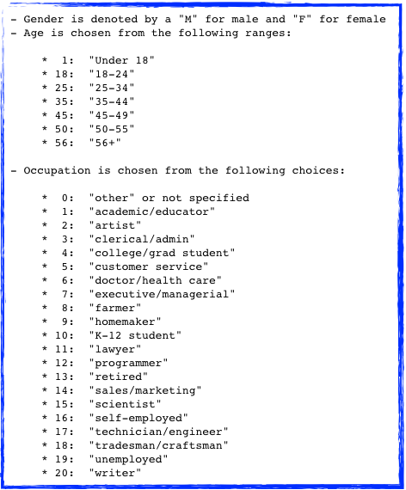

Our Dataset
movies.dat
1::Toy Story (1995)::Animation|Children's|Comedy
2::Jumanji (1995)::Adventure|Children's|Fantasy
3::Grumpier Old Men (1995)::Comedy|Romance
4::Waiting to Exhale (1995)::Comedy|Drama
5::Father of the Bride Part II (1995)::Comedy
users.dat
1::F::1::10::48067
2::M::56::16::70072
3::M::25::15::55117
4::M::45::7::02460
ratings.dat
1::1193::5::978300760
1::661::3::978302109
1::914::3::978301968
1::3408::4::978300275
Columns are separated by ::

Slide 5
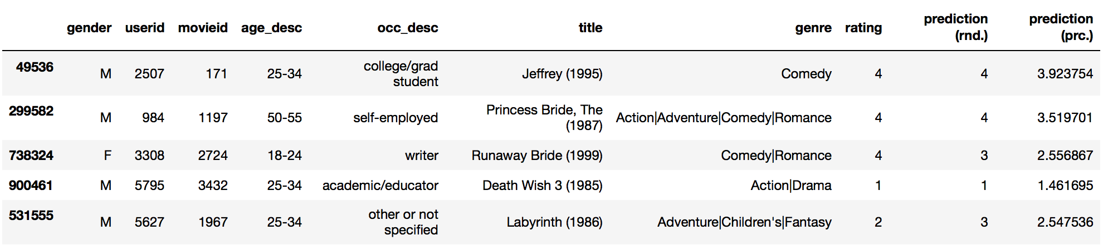
The Goal
Our Goal is to predict the rating for a given pair of user id and movie id
MF Accuracy: 45.008881%

Slide 6
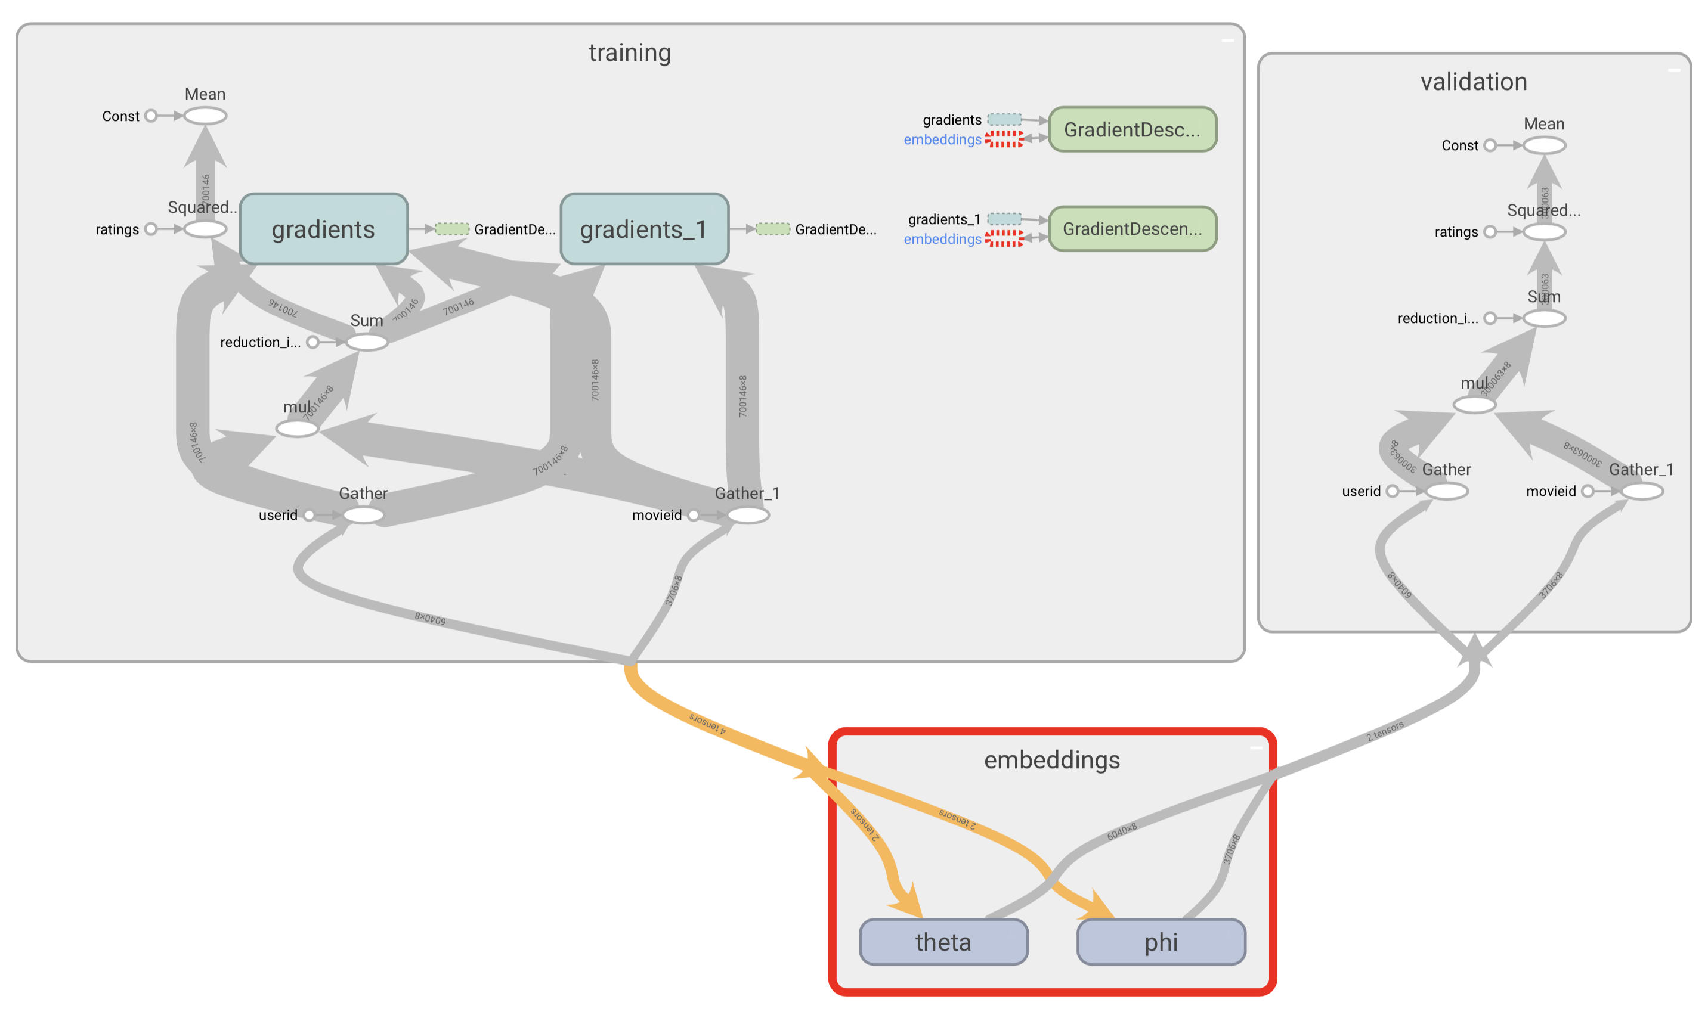
Implementation Steps
Load data
Set up our parameters: θ and ϕ
Define non-trainable variables: user ids, movie ids and ratings
Calculate the prediction and cost
Train and evaluate the model
tensorboard --logdir=path/to/log-directory

Slide 7
Deep and Wide Notebook
Demonstrate how to use the tf.esimator API to train a wide linear model and a deep feed-forward neural network.

Slide 8
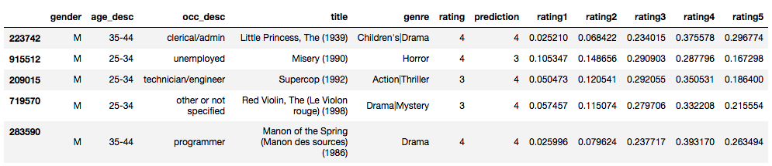
The Goal
Our Goal is to predict the rating category for a given pair of user id and movie id
DnW Accuracy: 34.907003%

Slide 9
Implementation Steps
Data preprocessing
Build inputs
Hash categorical features
Create embeddings of sparse features for the deep model
Define features for both the deep and the wide part of the model
Train and validate the model
Big chunk !
Preparing the inputs
model = tf.contrib.learn.DNNLinearCombinedClassifier(…...
)

Slide 10
Deep Matrix Factorization Notebook
Demonstrate how to use the tensorflow lower API to build a DNN model from scratch.
Notes:
With the inspiration of DnW, can we build a DNN that can improve the performance of traditional mf?

Slide 11
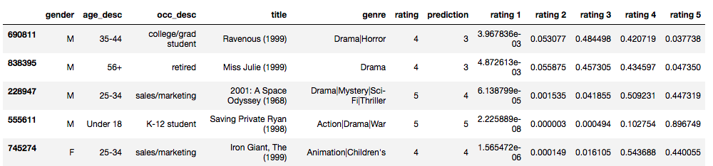
The Goal
Our Goal is not only to get a single prediction value, but also to know the probability distribution of the prediction.
DNN Accuracy: 50.559383%

Slide 12


The Advantage
With this additional probability information we can assess the risks and certainty of our result.
Notes:
The two graphs on the left shows positive indicator for recommendation.
Take the first one for example, true rating is 5, our prediction is 5. We know that the movie is highly likely to be rated 5, also has possibility to be rated 4. But it will absolutely not be rated 1 or 2. So we could be quite certain to recommend this movie to this user.
The 2nd one, even though we predicted wrong value, the true value is 5, and our prediction is 4, but we know that it’s highly likely to be 4, and almost 20% to be 5, it’s really unlikely to be rated 1. or 2, it’s also safe to recommend this movie to this user.
The red circled graph on the right is exactly opposite, it’s rated neutral, but the distribution is more towards the left side, we should maybe not recommend this movie at all.

Slide 13
The Model
Relu
Relu
Relu
Softmax
P(rating1)
User Embeddings
P(rating2)
P(rating3)
…
…
…
P(rating4)
Movie Embeddings
P(rating5)
Input Units
Hidden Layers
Output Units
Notes:
4 layer neural network, with activation function: relu, relu, relu, softmax.
Input layer is the element wise product of the user embedding and the movie embedding.
Cost function: a combination of cross entropy and mean squared error.
User embedding and movie embedding will be initialized with the results from matrix factorization model.
First 50 epochs only update weights and bias in DNN, from 51th epoch train model end to end.

Slide 14
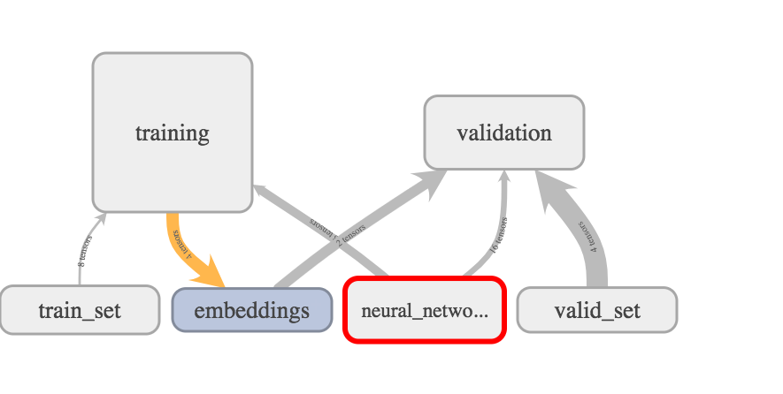
Implementation Steps
initialize the movie and user embeddings with the results trained in MF model
initialize the DNN parameter W and b
calculate Z n
calculate the prediction
calculate the loss
train and valid the model
tensorboard --logdir=path/to/log-directory

